Slide 1
Results

Slide 2
So far
Hyperparametertunings are done
All pipelines are evaluated on test data
number speakers: (61,)
Number of speakers in train: 49, val: 4 test: 8
Number of segments in train: 18510, val: 1416 test: 871
Model attention is visualized

Slide 3
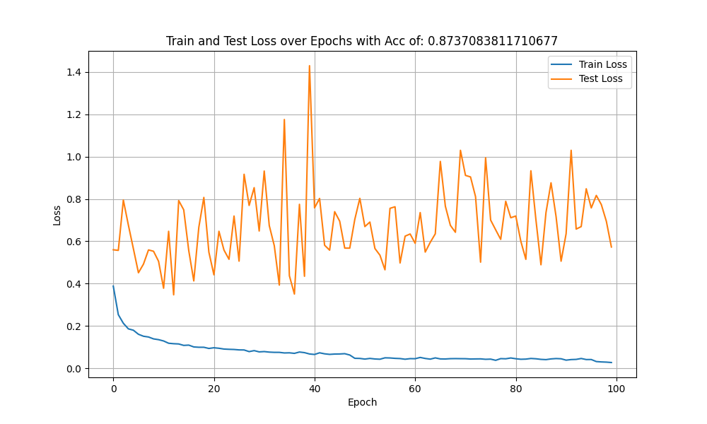
Mel

Slide 4
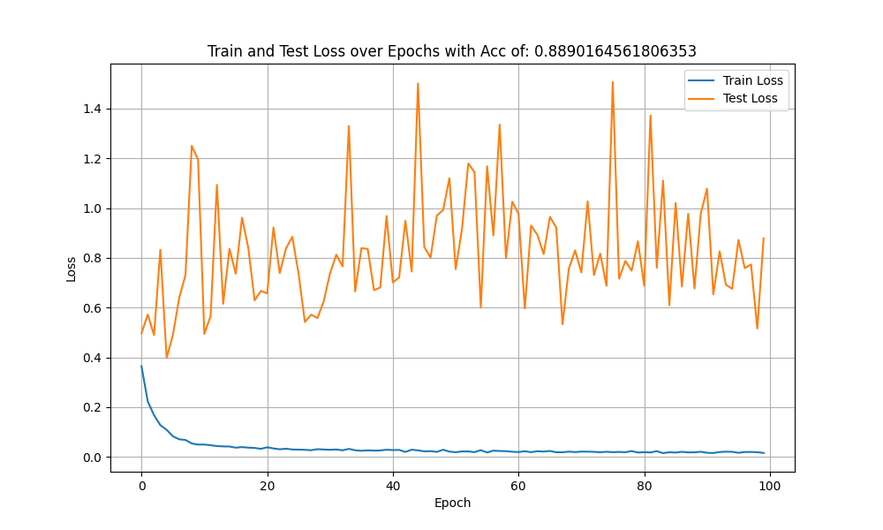
Mel+ATT

Slide 5
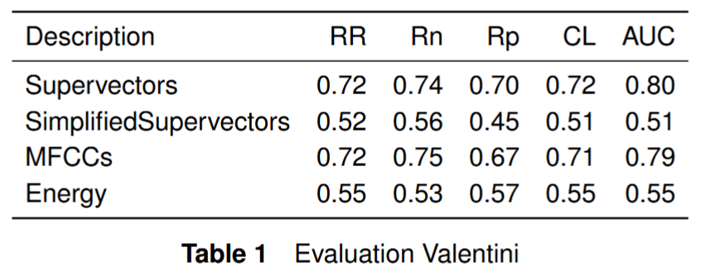

Slide 6
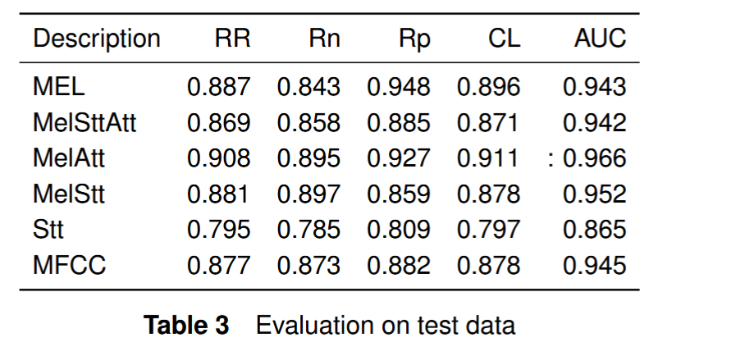


Slide 7
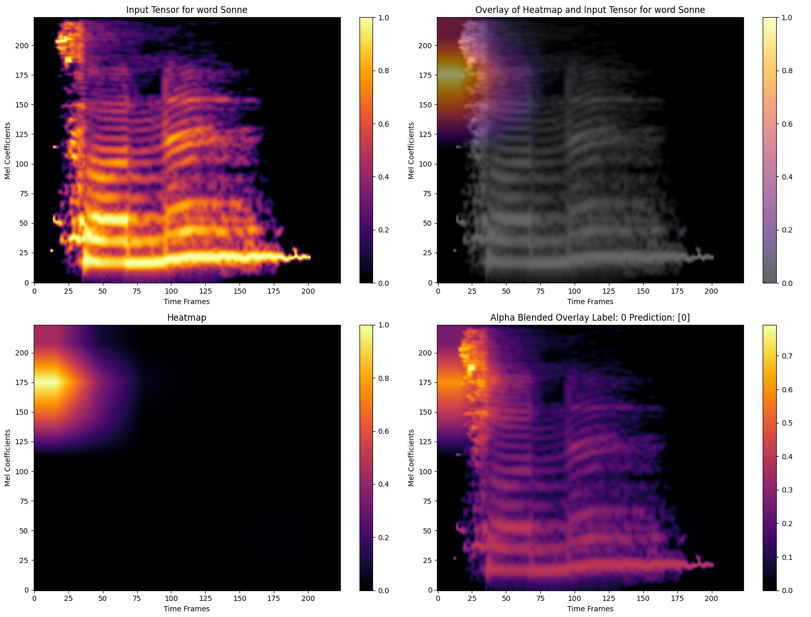

Slide 8
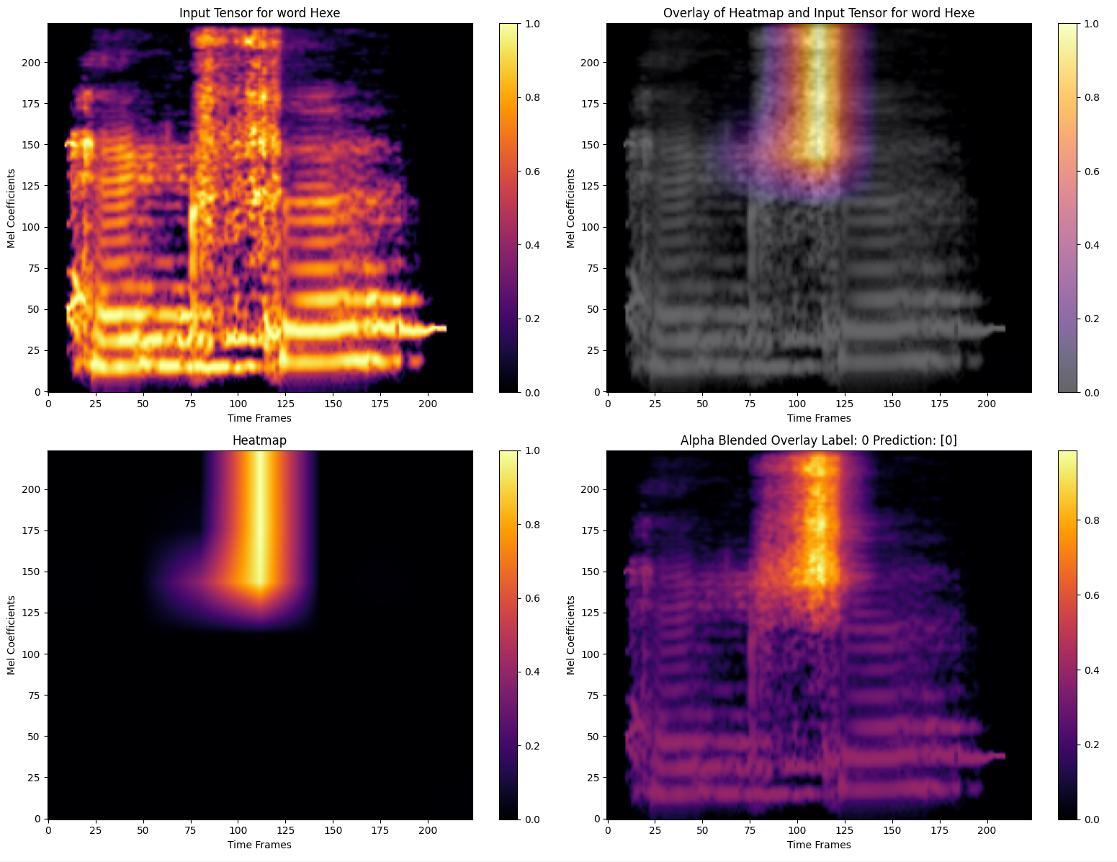

Slide 9
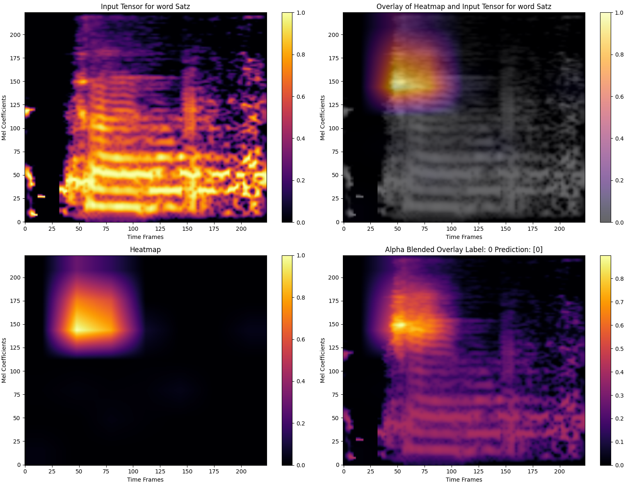

Slide 10
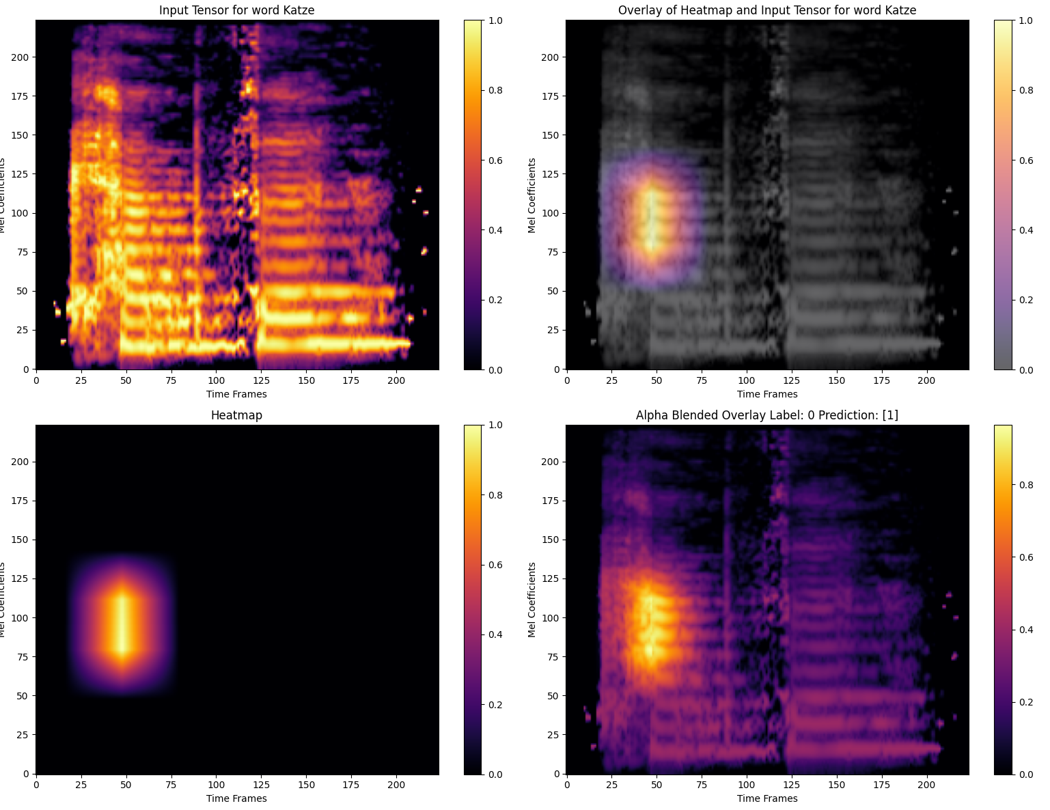

Slide 11
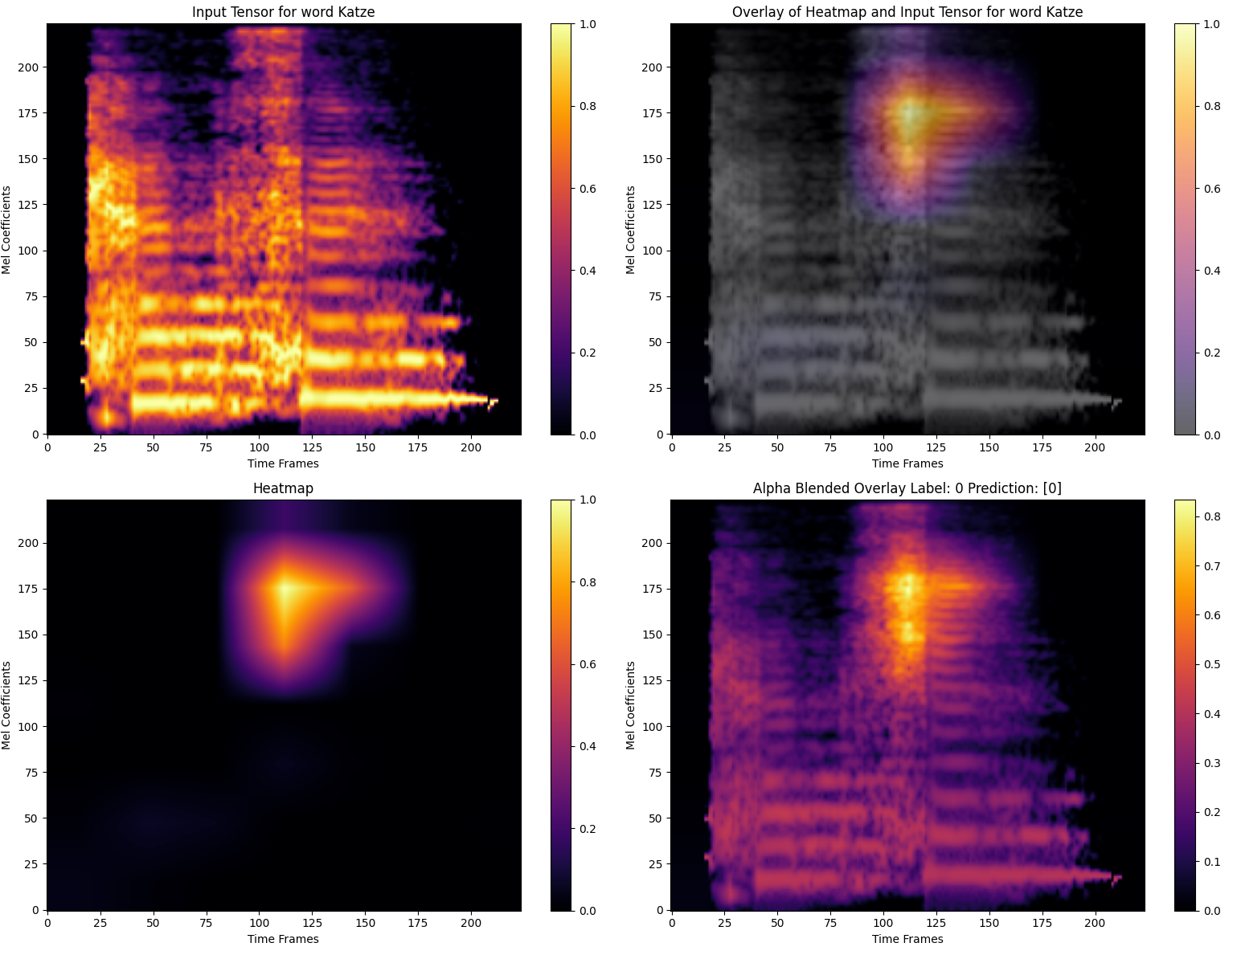

Slide 12
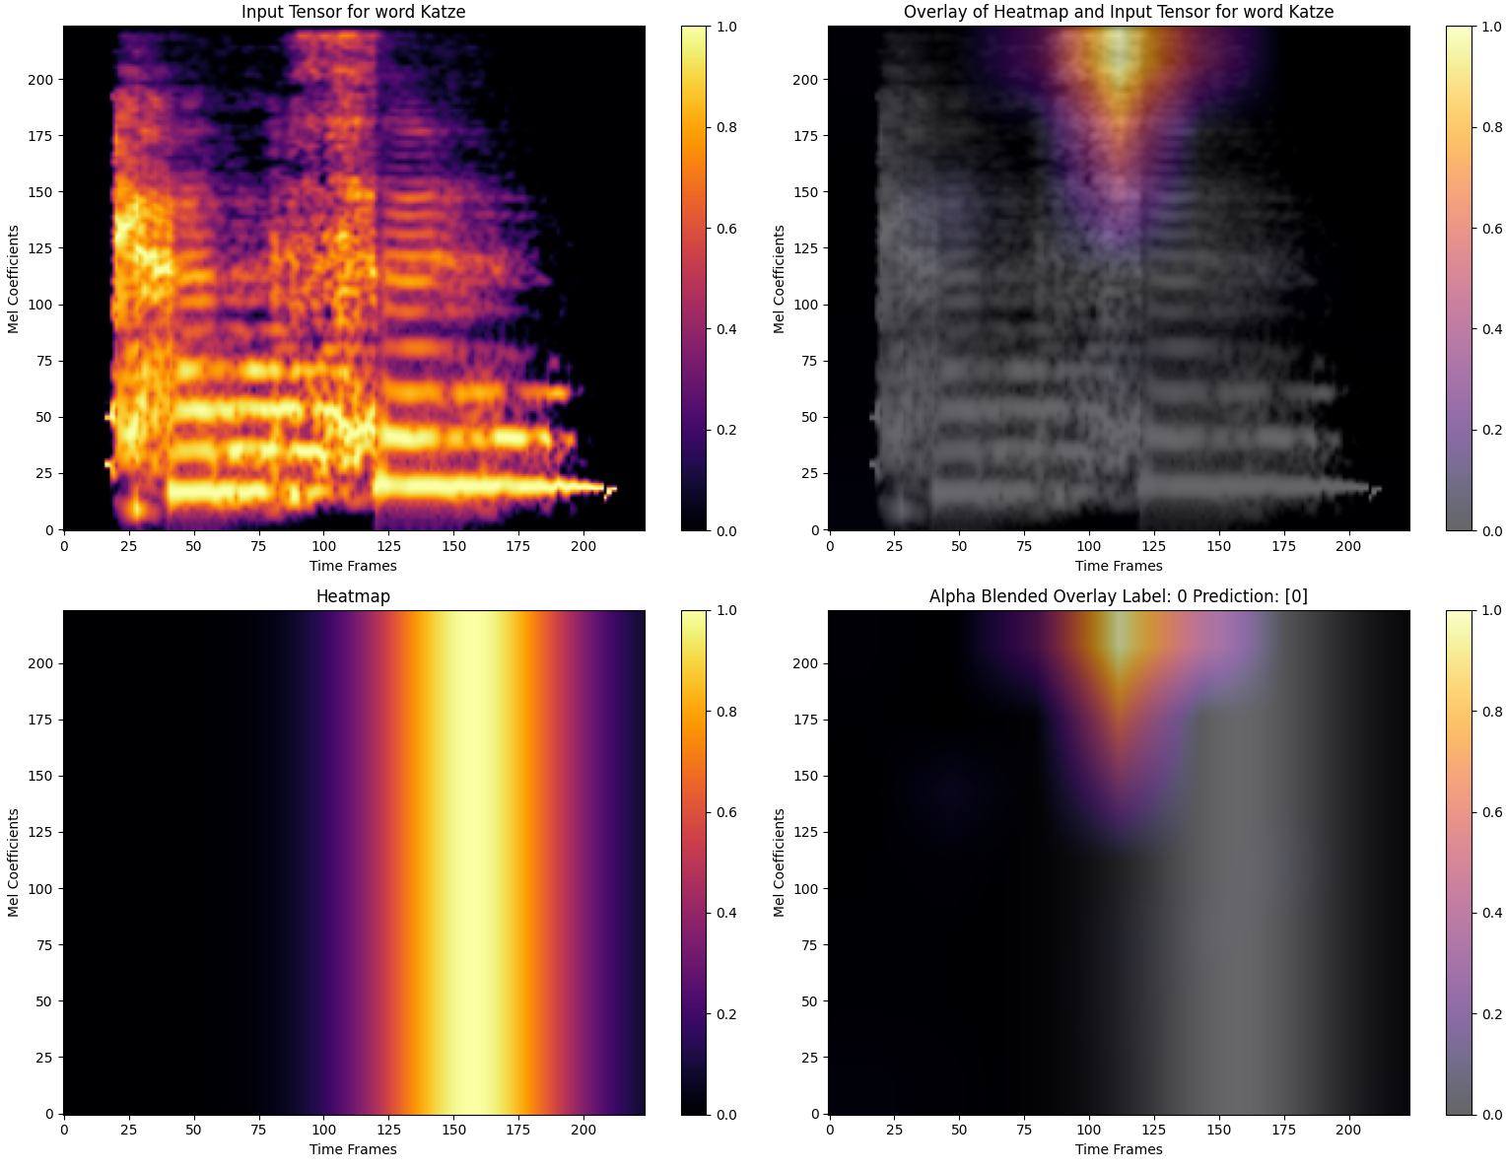
2 channel mel+att

Slide 13
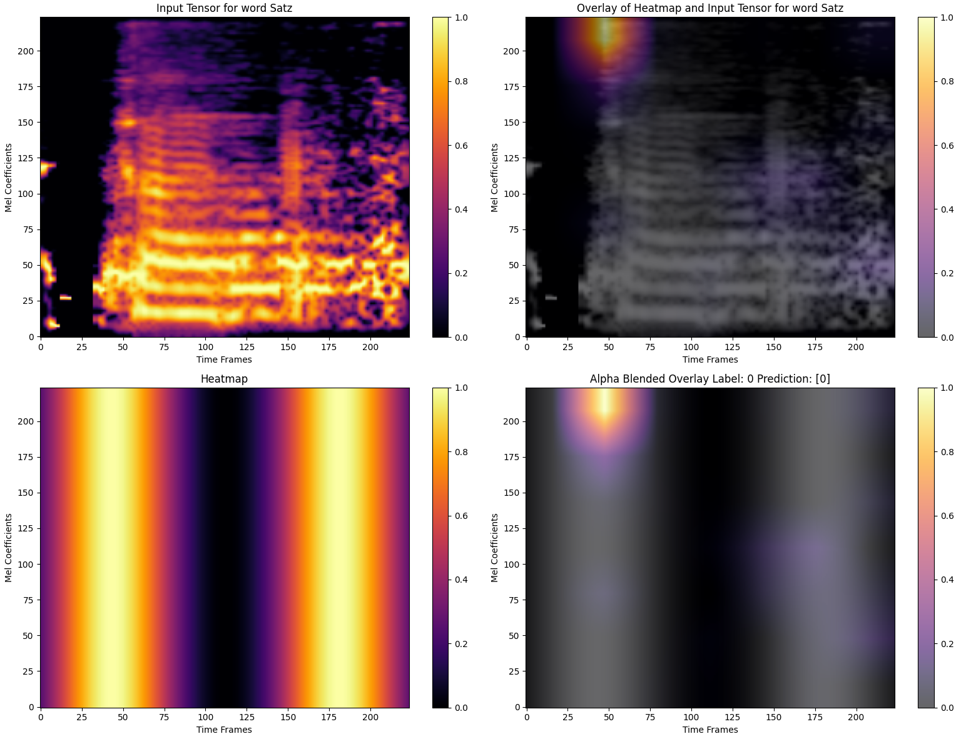

Slide 14
To Do:
Write write write
Implement MEL+ATT in App
Look at class wise predictions
Evaluate with sabine the Falsely predicted

